Slide 1
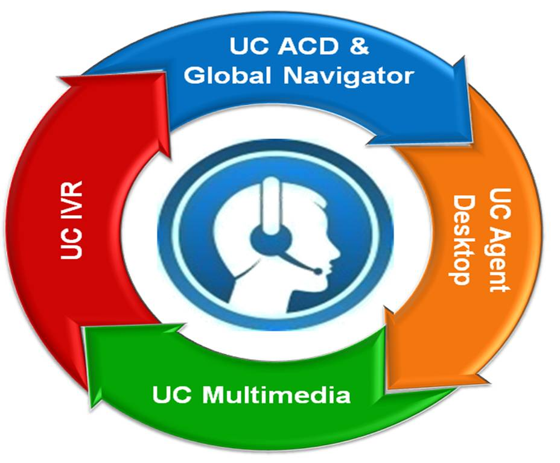
UCE Contact Center

Slide 2









UC Contact Center Suite
UC ACD (CallCenterWorX) & Global Navigator
Routing, Real-time Screen & Historical Reporting
UC Agent Desktop
Presence, Stats, Screen pop, Call Control
And Communication History
UC IVR (QueWorX)
    After Call Survey, Announce (ETA/QD), Adv. Routing
    Auto Attendant & Callbacks (Immediate/Scheduled & Web Callback)
…
UC Multimedia (ContactWorX)
Web Chat & Email
CHAT

Slide 3
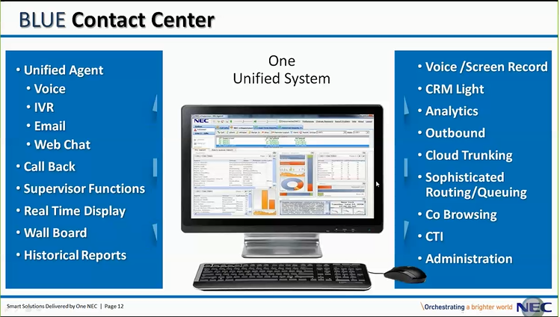
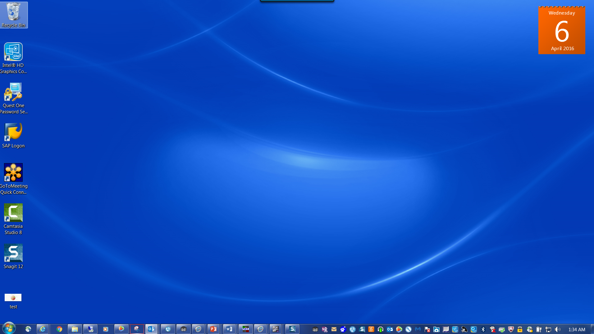
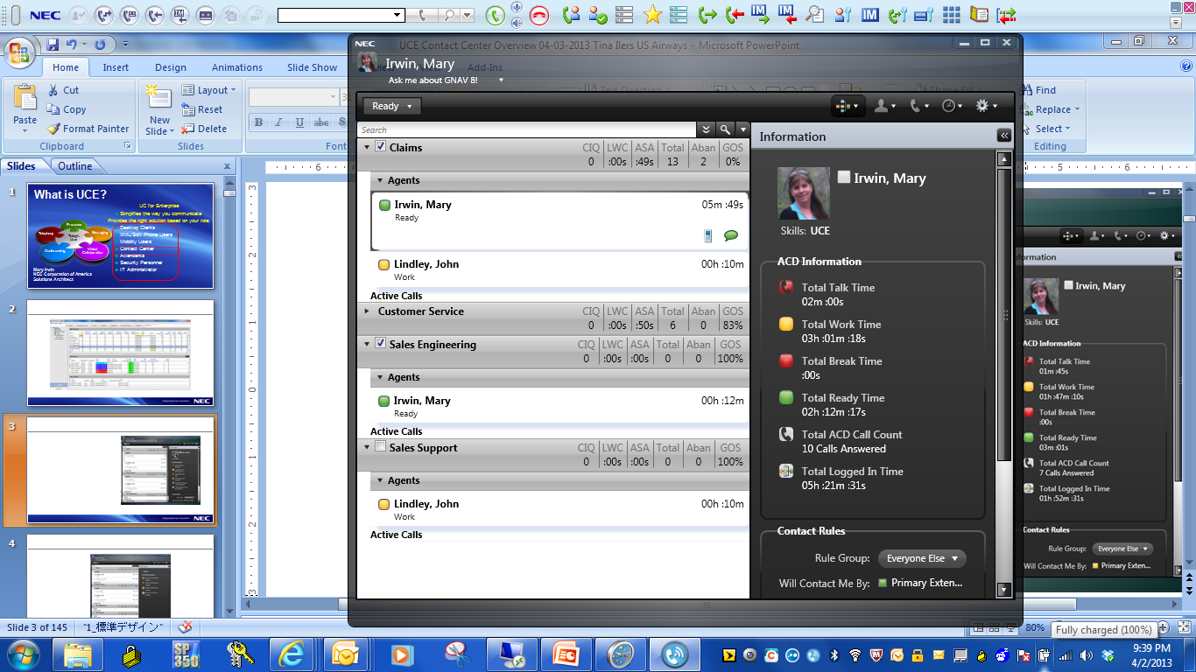
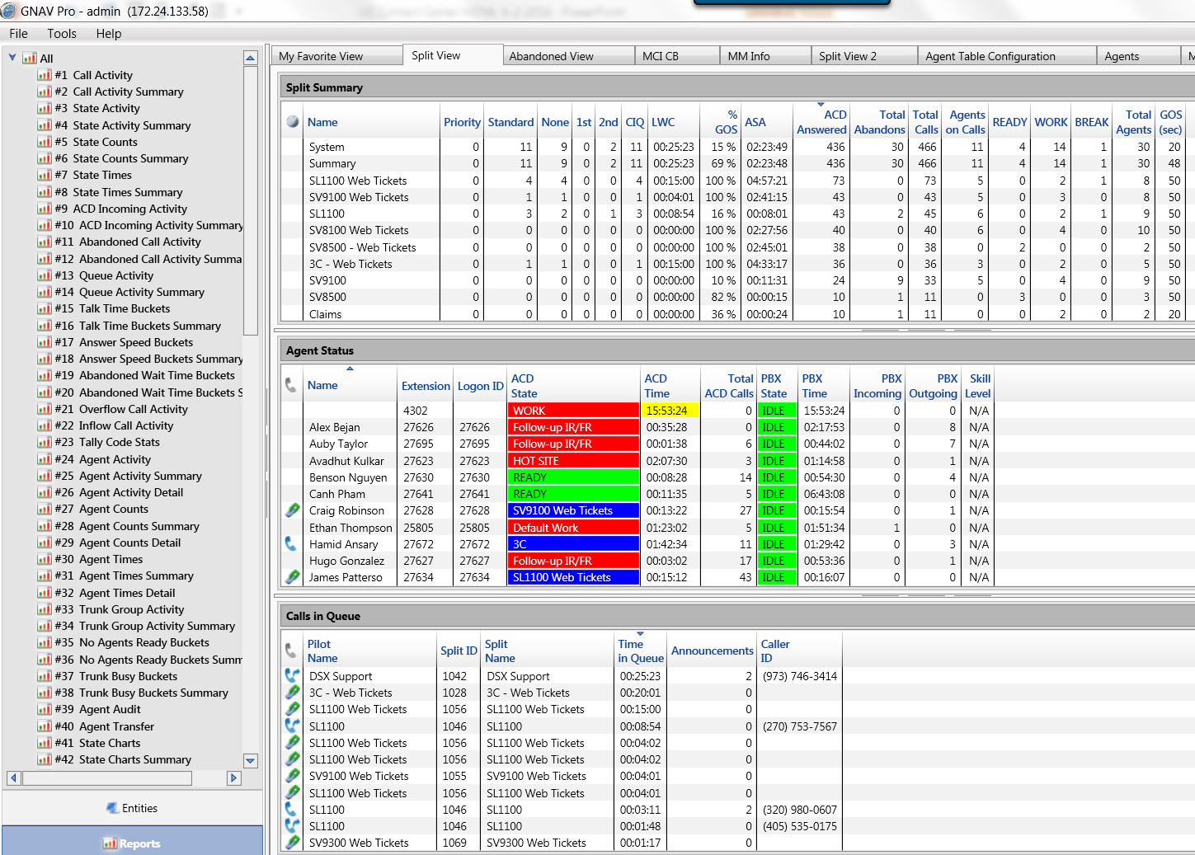
UCE Contact Center Solution
UC ACD Agent
  Voice
  Email
  Web Chat
Agent Desktop
  Presence
  Screen Pop
  Call Control
  Stats
  Wrap up
GNAV – Supervisor
  Real-time Display
  Calls in Queue View
  Capacity Analysis
  Custom Views
  Management Tools
  Split Mode Changes
  Historical Reports
  Scheduled Reports
  Virtual Wallboard
UC IVR
  Auto Attendant
  Announce (ETA/QD)
  Callback
  Routing
  After Call Survey
UC Multimedia
  CRM Lite
  Analytics
  Library
  Category Tracking
  Open URL Links
  Silent Monitor
  Join Conversations
Recording
  Voice
  Screen Capture
  After Call Work
WFM Integration
Agent
Supervisor

Slide 4
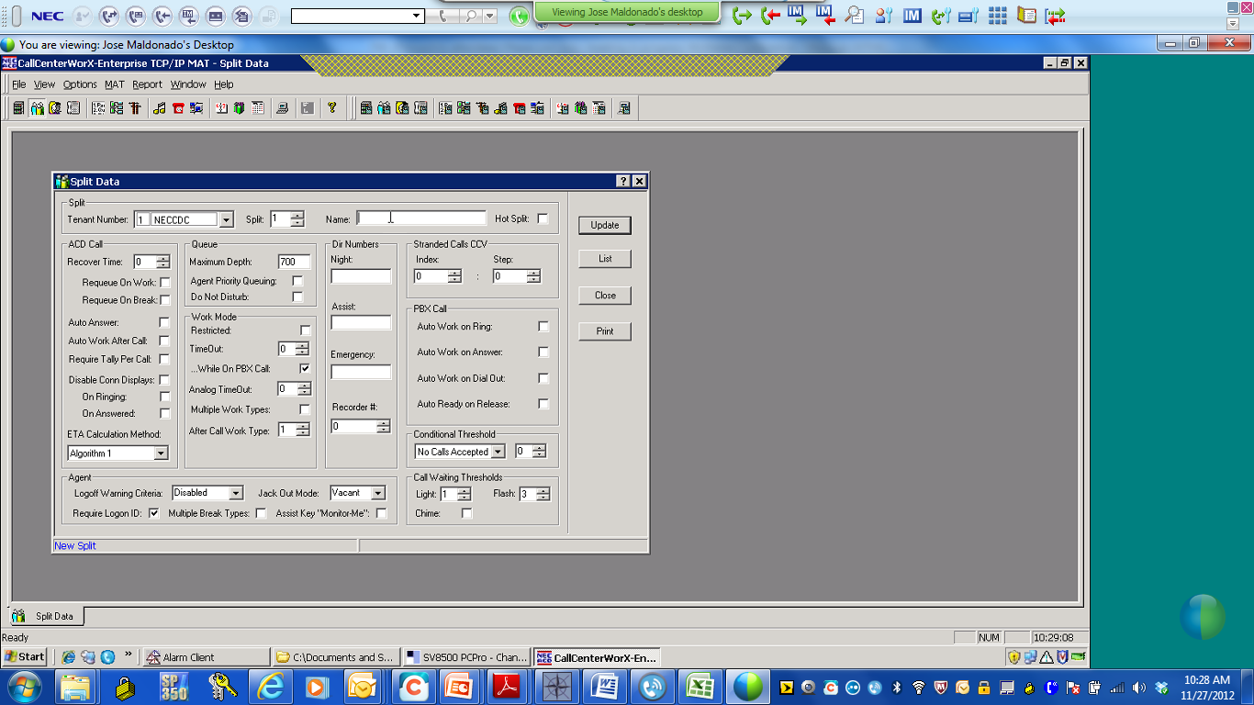
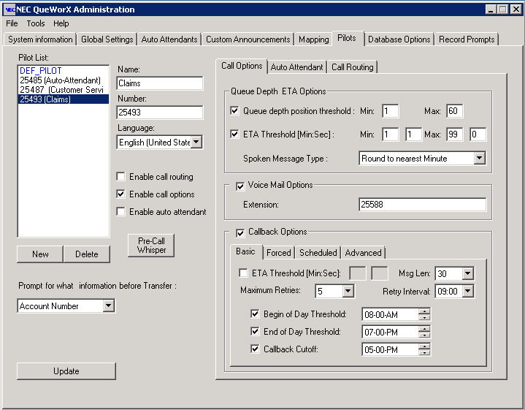
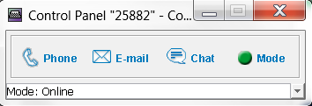
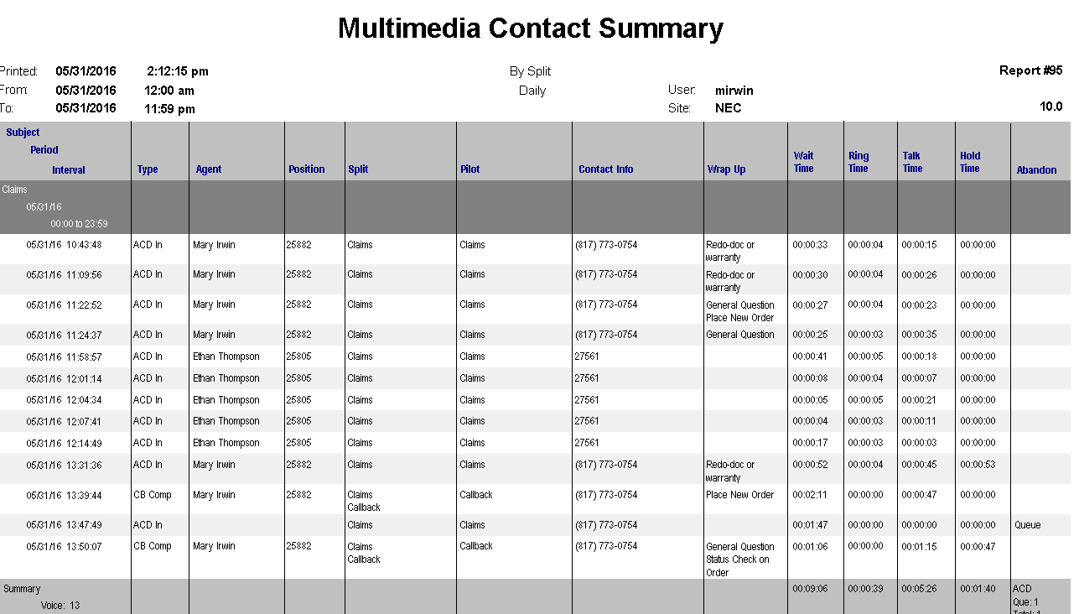
UCE Contact Center Solution
Automated Call Distribution
ACD - Routes calls to agents
Pilot Routing – Number Called
Routing
Split Queueing – Wait for Agent
Call Recover-Agent Can’t Answer
Business Line vs ACD Line
Interactive Voice Response (IVR)
Play Announcements to Callers
ETA Announcements
IVR
Position in Queue
Custom Announcements
Callback options
UC/Agent Desktop
Presence/Stats
Agent & Split Statistics
Agent
Screen Pop
Call Control
Instant Message w/SME’s
Assist other Splits
Multimedia
Email & Web Chat
Emails – Answer & Track
Multimedia
Web Chats – 4 at a time
CRM Lite–View All Transactions
Phone Notes – Document Conv
Supervisor Dashboard
Real-time Windows
Historical Reporting
Call Stats– ASA/LWC/Abandon
Supervisor
Agent Status – States & Calls
Calls in Queue– Track Progress
Reporting – On-demand/Sched

Slide 5
Solution Interactions
Automated Call Distribution
ACD - Routes calls to agents
Pilot Routing – Number Called
Routing
Split Queueing – Wait for Agent
Call Recover-Agent Can’t Answer
Business Line vs ACD Line
Agent Personal Queues
Announcements
Assistance - ACD agent
Automatic answer
Auto work for PBX calls
Break modes (9)
Call Control Vectors
Call distribution to agents
Call forwarding - split
Call recover
Call transfer to split queue
Call waiting indication
Connection display
Delay Announcements
Do not disturb - split
Holiday scheduling
Hot split
Language default
Logon / logoff
Monitoring - ACD Supv
Logoff warning
Monitor me
Multiple Splits
Multi-split agent (32)
Night service - ACD
Non-ACD call
Overflow Outside
Personal emergency and assist
Pilot numbers
Priority queuing
Queuing - ACD
Skills-based Routing
Splits
Split display - ACD position
Split selection
Stranded call routing
Tally count
Tally-oh codes
Tally required
Time of day/ week routing
Variable queuing
Work modes (99)
Work mode time limit
Week Schedules
Zip tone

Slide 6

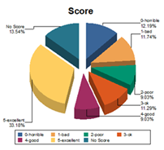
Solution Interactions
Automated Call Distribution
ACD - Routes calls to agents
Pilot Routing – Number Called
Routing
Split Queueing – Wait for Agent
Call Recover-Agent Can’t Answer
Business Line vs ACD Line
Optional
ETA Announcements
Interactive Voice Response (IVR)
Play Announcements to Callers
Position in Queue
IVR
AA Announcements
Custom Announcements
Callback options
Routing
After Call Survey
Announcement
  ETA Announcement
  Queue Depth
Auto Attendant
  Custom Announcements
  Pre-call Whisper Announcements
An announcement provides the agent with additional information about how to handle calls
      The system “Whispers” a message prior to connecting the caller i.e., “This is a Customer Service call.” or “This is a Billing call.” Or, “Smile when you talk!”
Callback
  Immediate, Scheduled & Web Callback
Routing
    Account Code Routing/ANI/Area Code Routing
After Call Survey
Your call will be answered in approximately 2 minutes
Or There are 4 callers ahead of you
Press 1, 2, 3 4, etc
This call may be monitored or recorded…
During peak/busy hours, offer callbacks. Keep Callers place in line or schedule for a more convenient time
On a scale of 1 to 5, with 1 being Very Likely and 5 being Not Likely
How likely is it that you would continue to do business with our company?
How likely is it that you would recommend our company to others?
UCE IVR is for licensed automation options - PS IVR is available for Self-service and custom integration

Slide 7
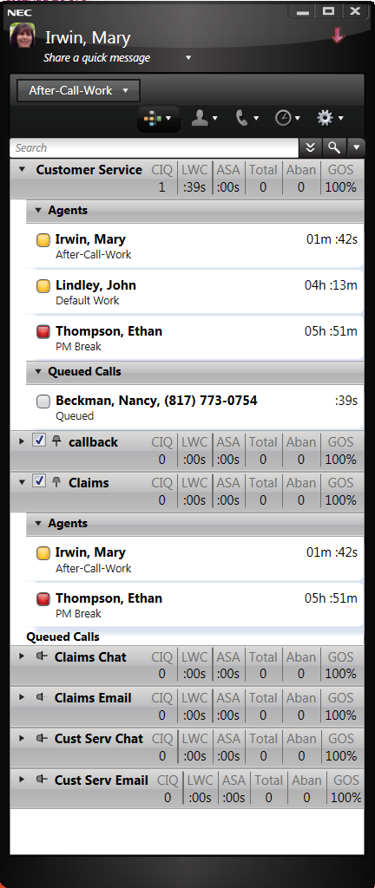
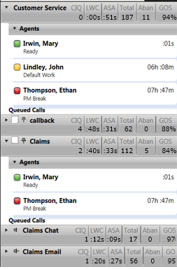
Solution Interactions
Automated Call Distribution
ACD - Routes calls to agents
Pilot Routing – Number Called
Routing
Split Queueing – Wait for Agent
Call Recover-Agent Can’t Answer
Business Line vs ACD Line
ETA Announcements
Interactive Voice Response (IVR)
Play Announcements to Callers
Position in Queue
IVR
Custom Announcements
Callback options
After Call Survey
UC/Agent Desktop
Presence/Stats
Agent & Split Statistics
Agent
Screen Pop
Call Control
Instant Message w/SME’s
Assist other Splits

Slide 8
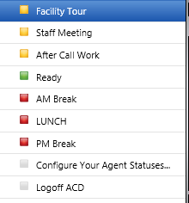
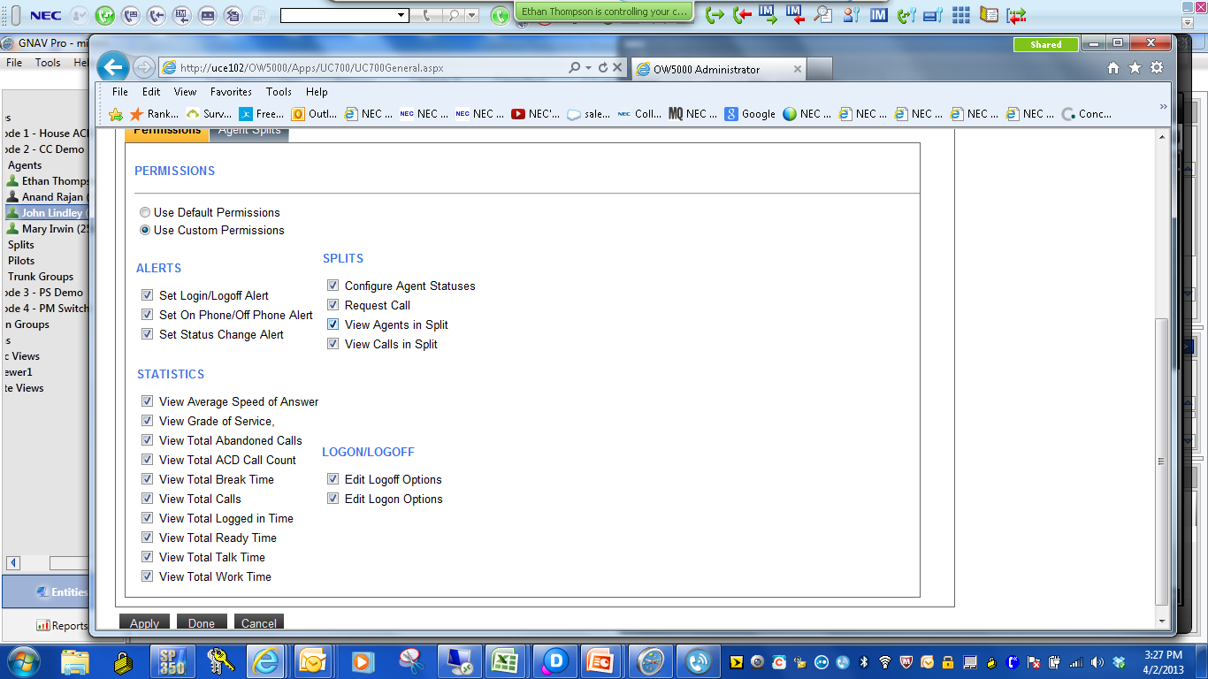
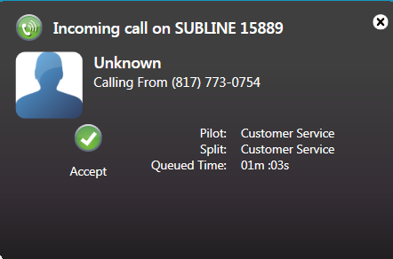
Desktop Client (Agent)
Move seamlessly from a business to an agent role
Instant Message with colleagues
Select presence states
View Split Statistics
Additional Agent information
  Ready/Work/Break Time
  Talk Time & Logged in Time
  Answered Calls
Communication History
  ACD Calls
  Answered & Missed Calls
  Instant Message History
Call Control
  Answer, Transfer, Conference & Hold
Screen Pop
  Call, Pilot and Split info
  Caller’s time in queue
CRM integration
Wrap Up Codes

Slide 9
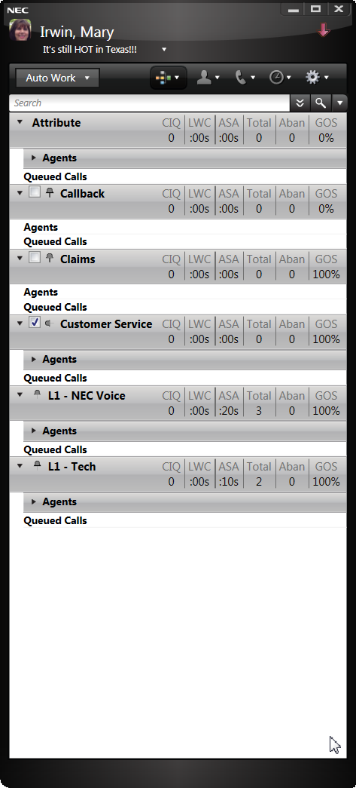
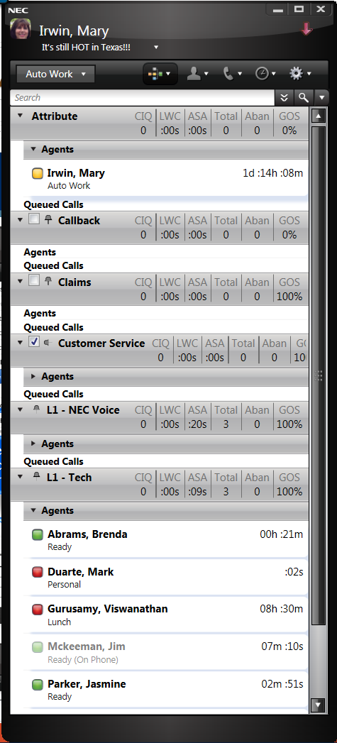
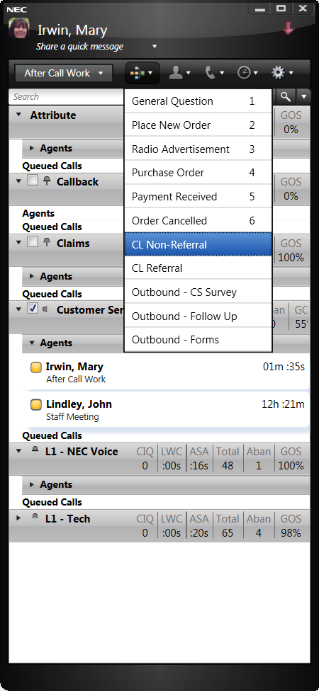
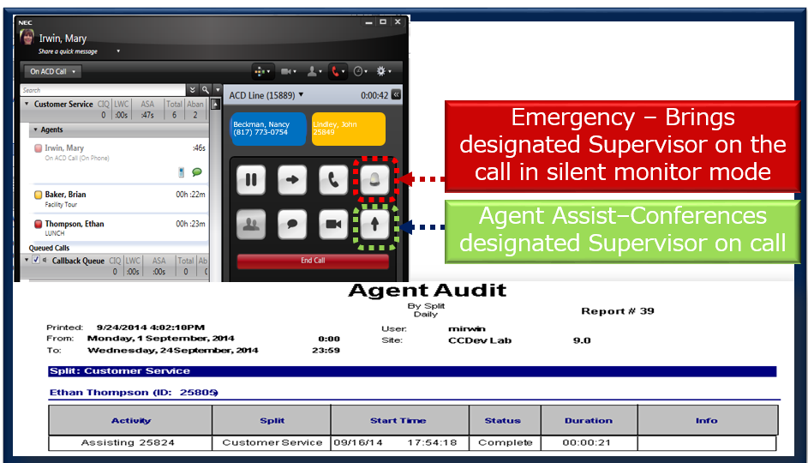
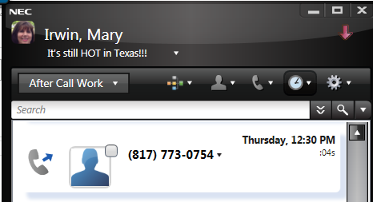
Agent Desktop
ACD Agent Desktop
  Assist & Emergency Options
  Wrap up Codes (Referrals verses Non-Referrals)
Logon/Logoff ACD from the Desktop Client
& Change States
Define Wrap Up Selections for Each Group
Use Call History for Dropped Calls

Slide 10
Solution Interactions
Automated Call Distribution
ACD - Routes calls to agents
Pilot Routing – Number Called
Routing
Split Queueing – Wait for Agent
Call Recover-Agent Can’t Answer
Business Line vs ACD Line
ETA Announcements
Interactive Voice Response (IVR)
Play Announcements to Callers
Position in Queue
IVR
Custom Announcements
Callback options
After Call Survey
UC/Agent Desktop
Presence/Stats
Agent & Split Statistics
Agent
Screen Pop
Call Control
Instant Message w/SME’s
Assist other Splits
Multimedia
Email & Web Chat
Emails – Answer & Track
Multimedia
Web Chats – Chat Phrases
CRM Lite–View All Transactions
Phone Notes – Document Conv

Slide 11
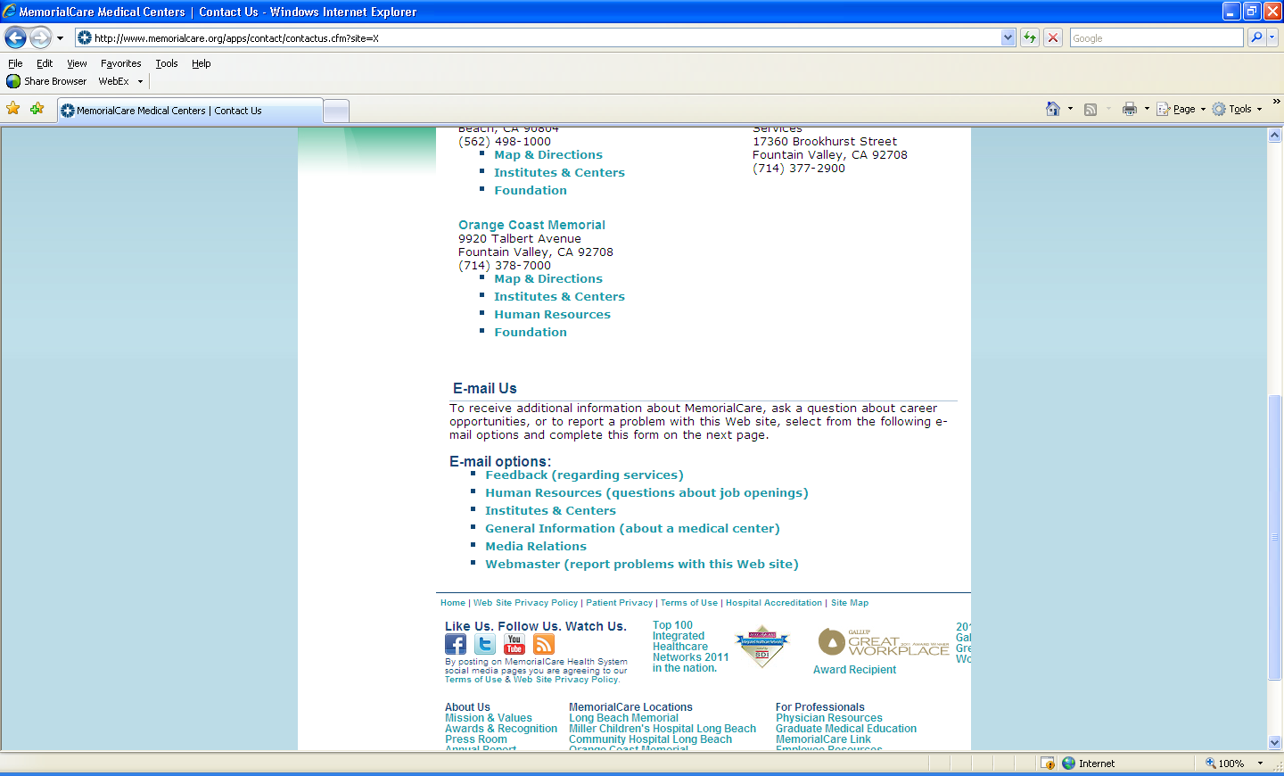
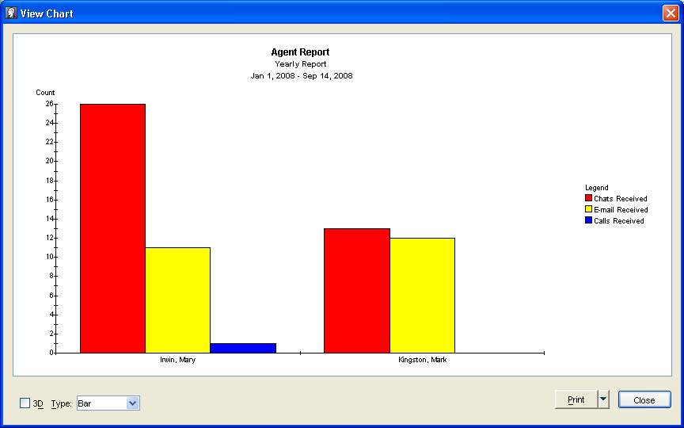
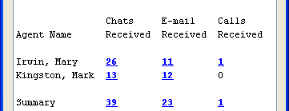
UCE - Multi-media (Web Chat, Email, Web Callback)
…
UCE Multimedia (ContactWorX)
Web Chat & Email
CHAT
Email & Web Chat Features
      Skills based routing via ACD
      Auto Suggest & Response
      Email Grouping
      Spell Check – Required/Optional
      Up to 4 simultaneous chat sessions
      Push web pages to customers
      Monitor chats in real-time
      Built-in Contact History
      Drill-down Reporting
Manage Phone Calls, Emails & Chats
Drill down on reports

Slide 12
Solution Interactions
Automated Call Distribution
ACD - Routes calls to agents
Pilot Routing – Number Called
Routing
Split Queueing – Wait for Agent
Business Line vs ACD Line
Interactive Voice Response (IVR)
Play Announcements to Callers
ETA Announcements
IVR
Position in Queue
Custom Announcements
Callback options
UC/Agent Desktop
Presence/Stats
Agent & Split Statistics
Agent
Screen Pop
Call Control
Instant Message w/SME’s
Assist other Splits
Multimedia
Email & Web Chat
Emails – Answer & Track
Multimedia
Web Chats – Chat Phrases
CRM Lite–View All Transactions
Phone Notes – Document Conv
Supervisor Dashboard
Real-time Windows
Historical Reporting
Call Stats– ASA/LWC/Abandon
Supervisor
Agent Status – States & Calls
Calls in Queue– Track Progress
Reporting – On-demand/Sched

Slide 13
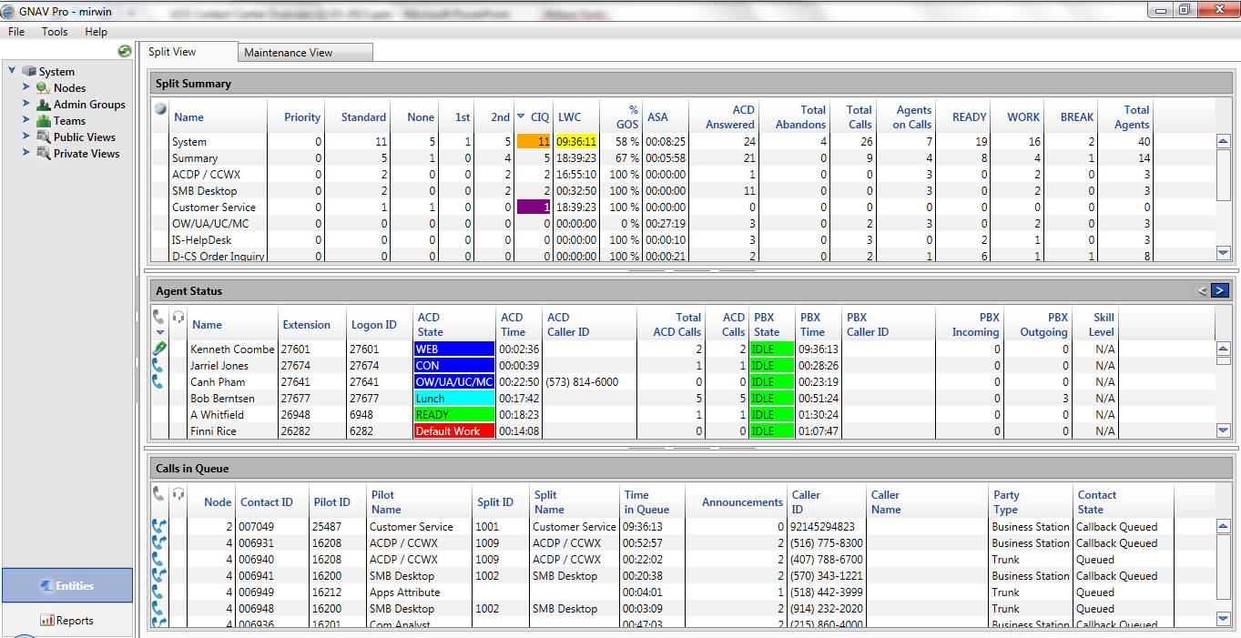
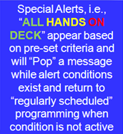
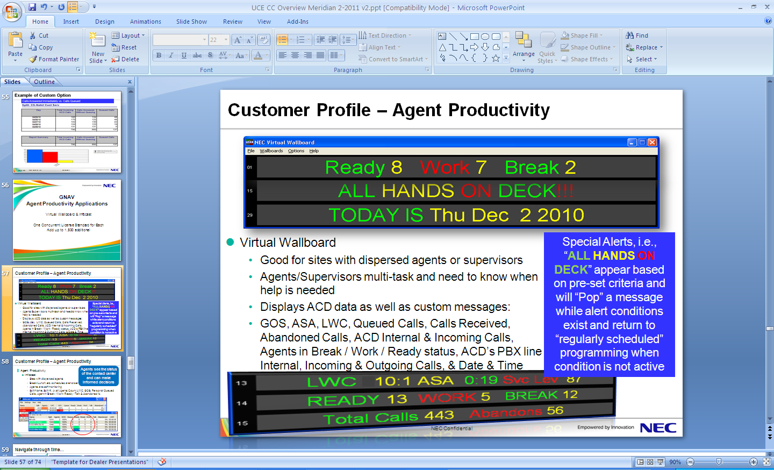
UC Contact Center – MIS
Global Navigator &
Virtual Wallboard
Global Navigator & Virtual Wallboard
  Interactive Real-time Screen
  View Call Activity
  Historical Reporting
  Manage Agents
  Manage Queued Calls

Slide 14
Supervisor/Manager Real-time View
Traditional data
Easy for Supervisors to begin tracking via the Real-time Screen immediately.
All splits/agents assigned to their login ID will appear in the default view at initial logon

Slide 15
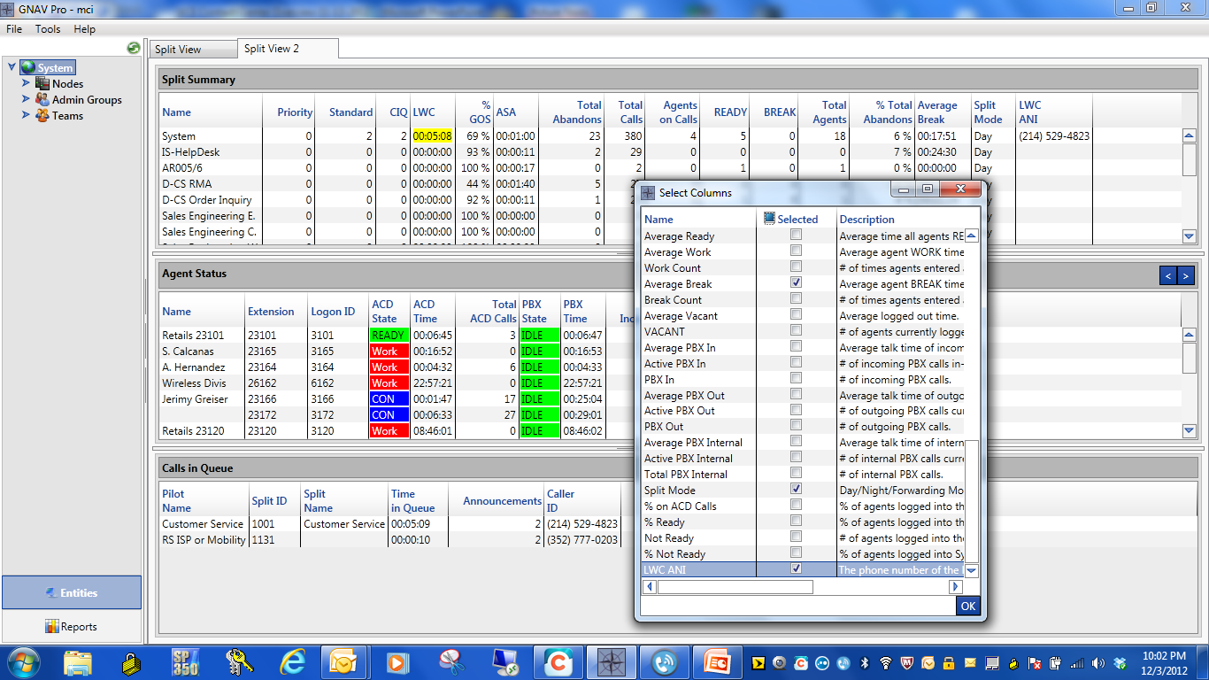
Right-click in any window to bring up the additional database viewing options

Slide 16
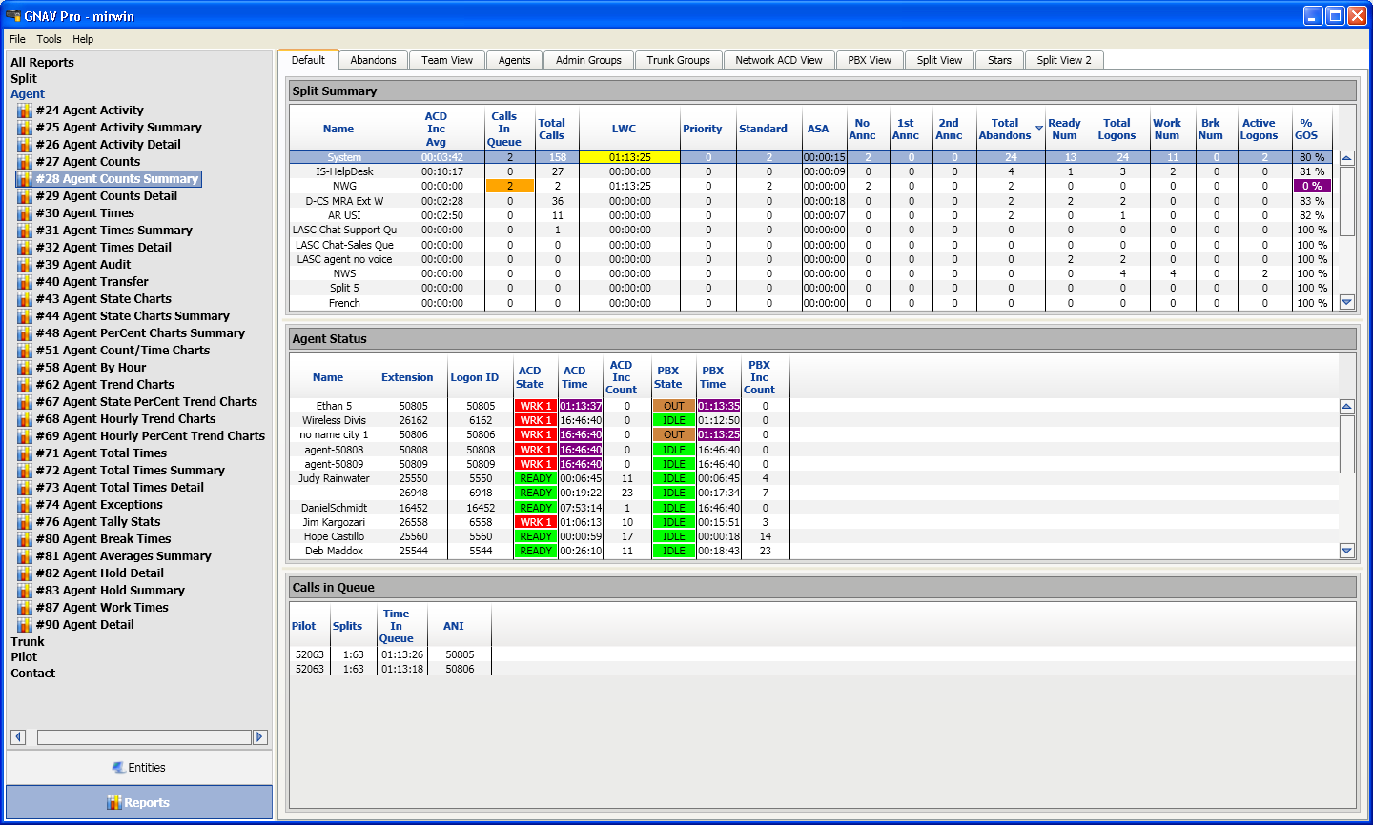
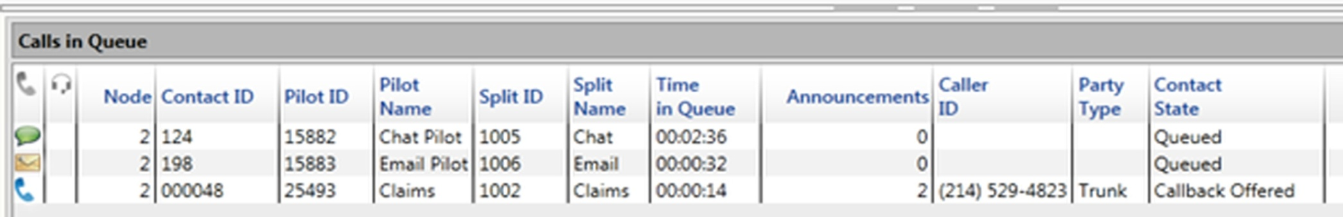
At a Glance
Agent States – Color Coded for easy identification
Alerts for Important Conditions – color escalation
Call volume by Agent – See anomalies
READY
BREAK
WORK
Cust Svc
25802
Agent States
Chats
Calls
Calls/Emails & Chats in Queue
By System | Split | Team | Status
Emails
Calls
Add UCE MM Modules to integrate Web Chat & Email

Slide 17

Business Analytics
Global Navigator
3 Level Alert Options
Level 2 Alert
Visual/Email
Level 1 Alert Visual
Level 3 Alert
Color Escalation
Visual/Email/Wallboard/Sound

Slide 18
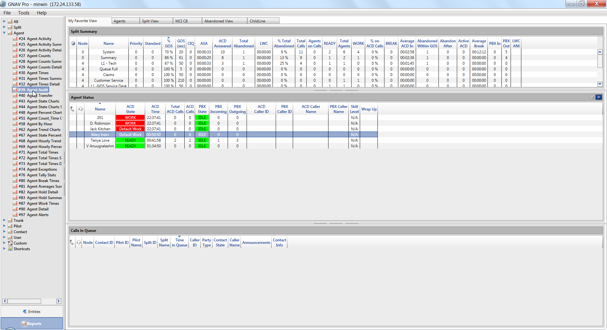
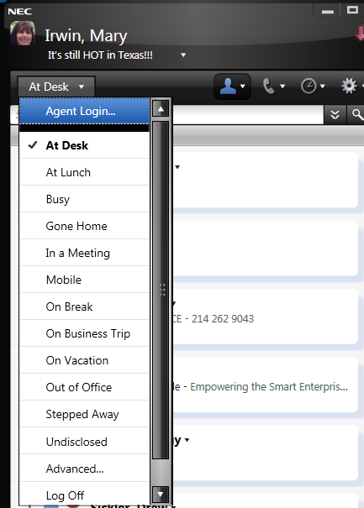
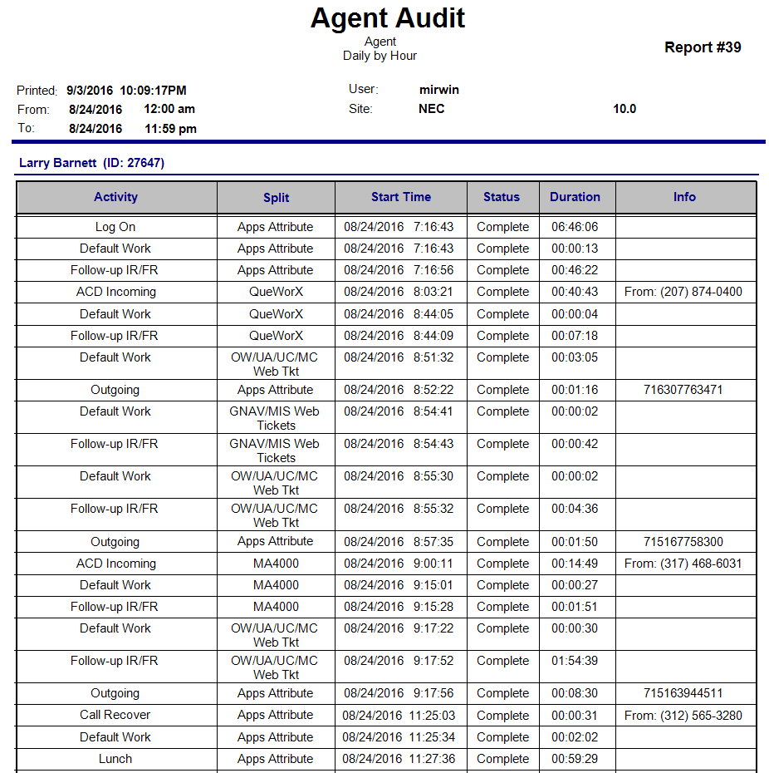
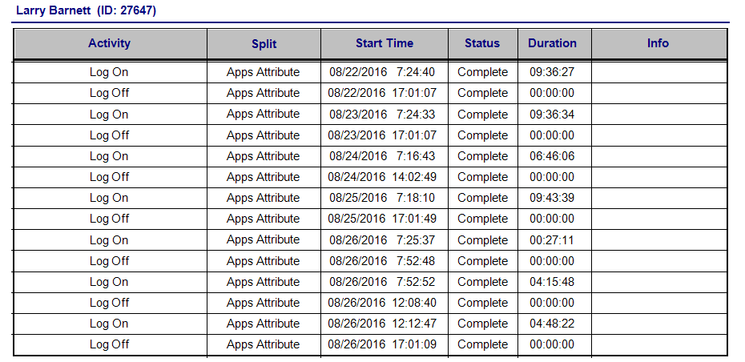
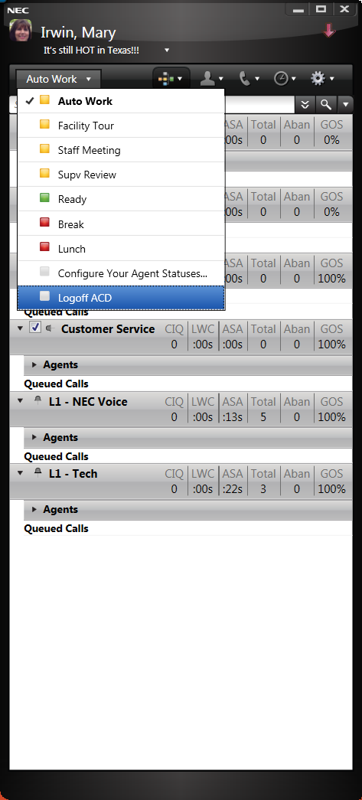
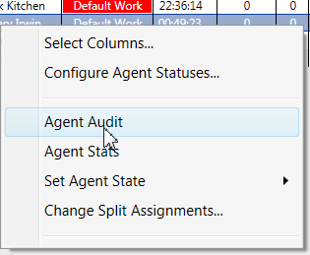
Business Analytics
Agent Logon/Logoff
Manage their States
Agent Audit Reports Show All Events
Mary Irwin (ID 14453)
Mary Irwin (ID 14453)
Real-time reporting Directly from the RTS along with Historical

Slide 19
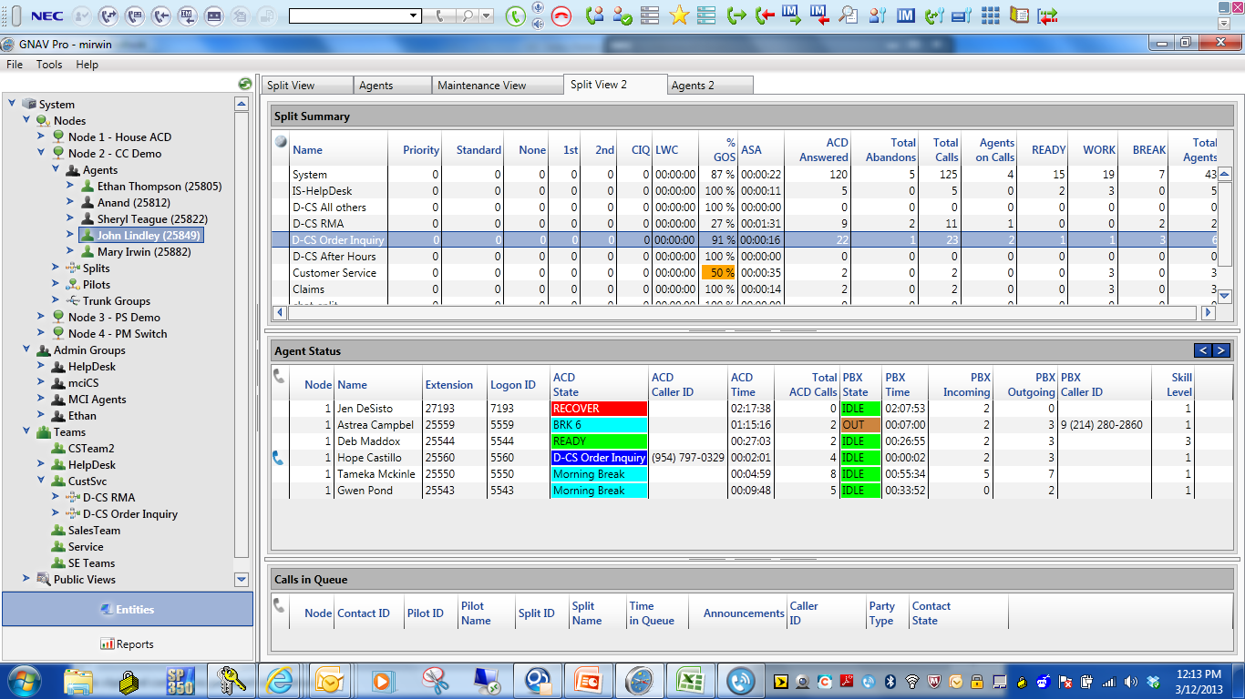
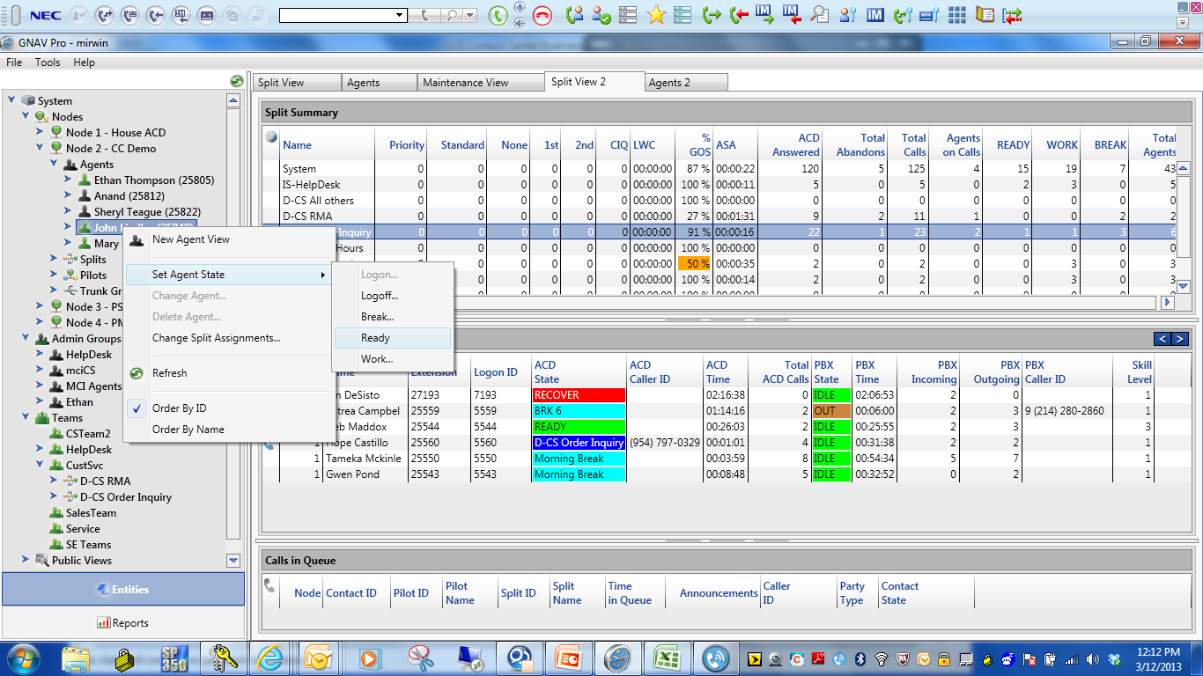
Business Analytics
Logon Agents/Change States
Modify Split Assignment
Change Skill Level
Dynamic/Immediate
Temporary/Permanent
Tree View Entities

Slide 20
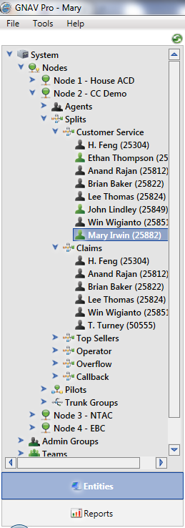
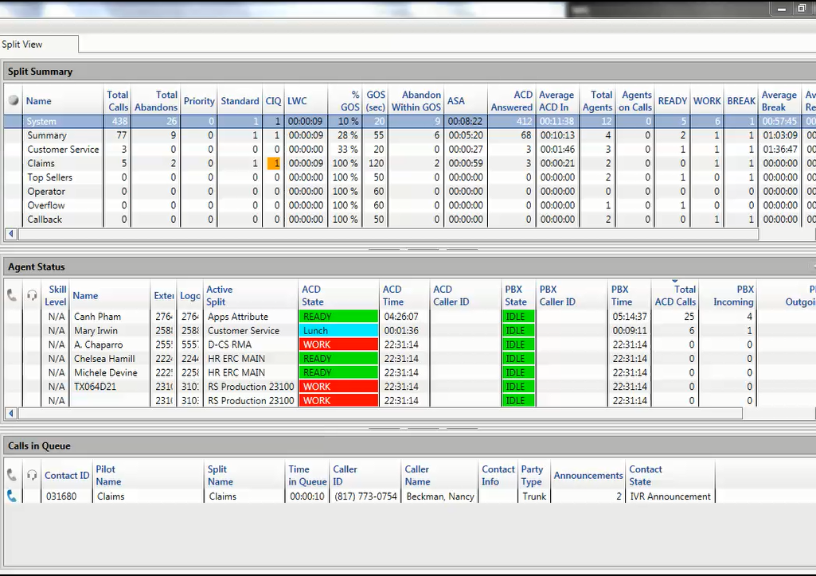
Business Analytics
Drag & Drop Agents or Callers
Drag & Drop Agents or Callers
Drag & Drop Agents

Slide 21
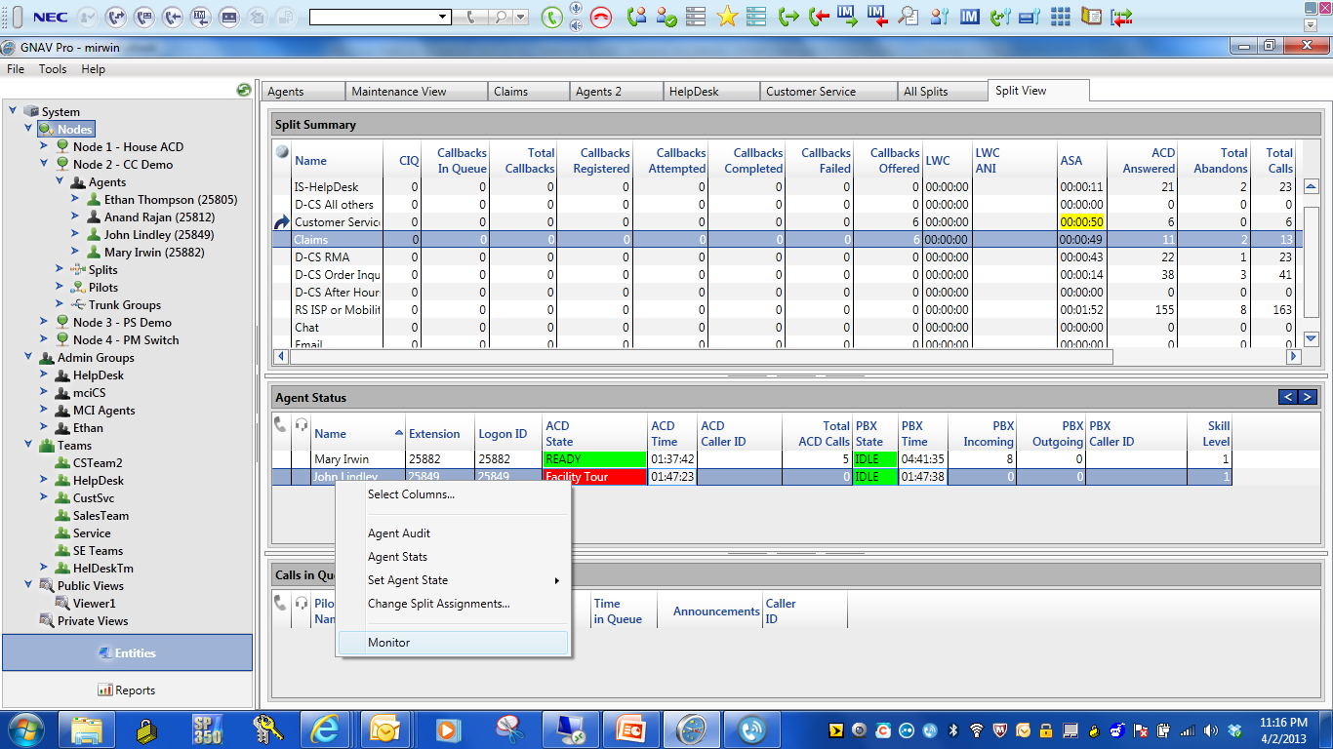
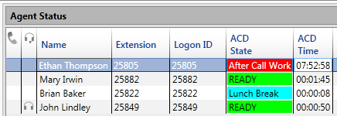
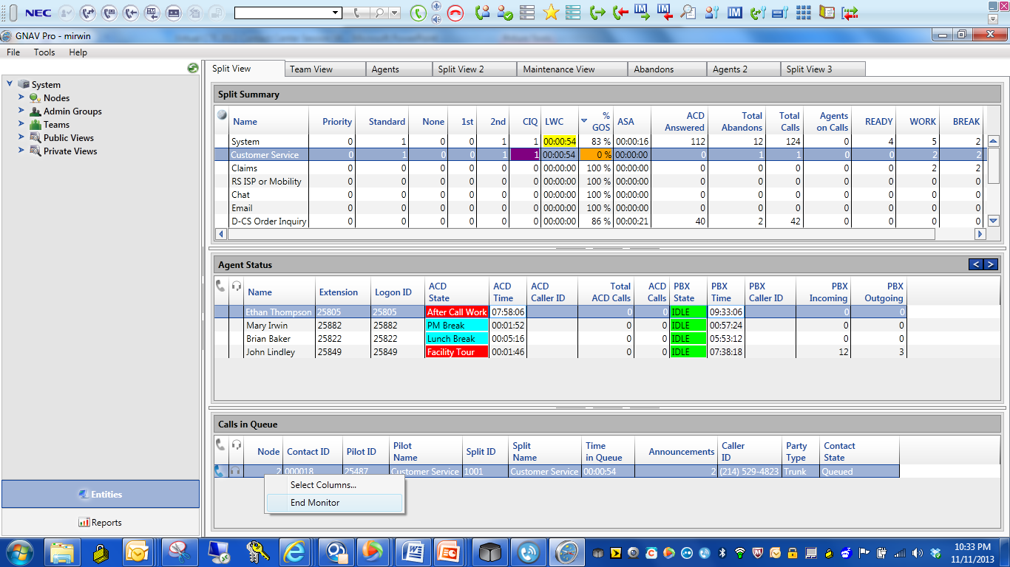
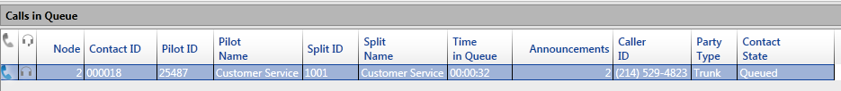
Silent Monitor/Barge using Phone or RTS
Silent monitor/barge from the GNAV client real-time screen (RTS)
Monitor Agents or Calls

Slide 22
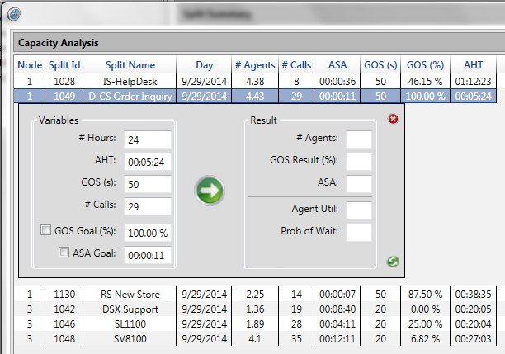
Capacity Analysis

Slide 23

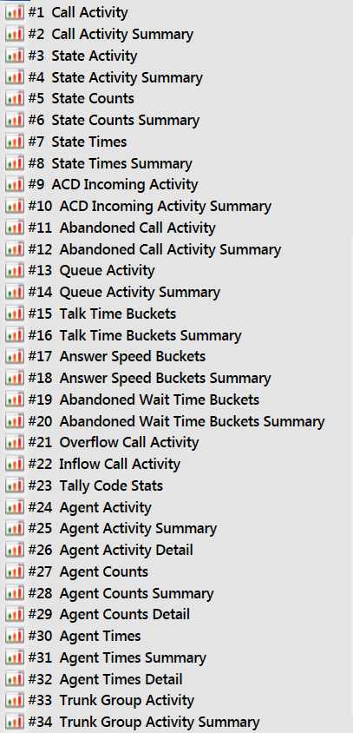
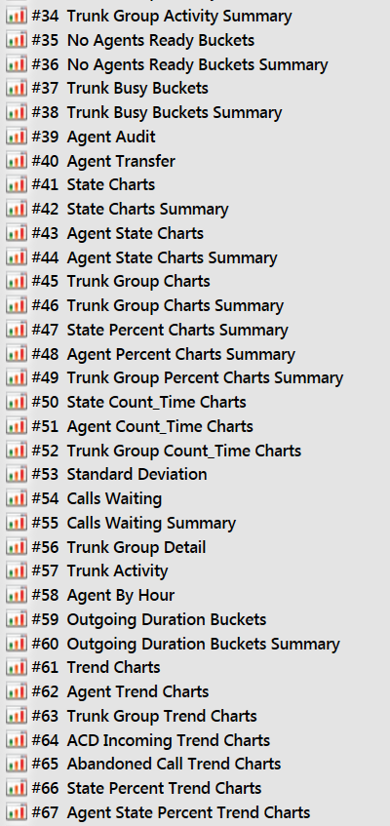
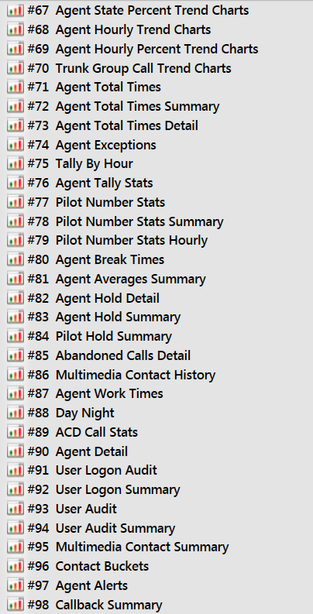
Business Analytics
Historical Reporting
98 Standard Reports - Export PDF, Excel, Word,

Slide 24
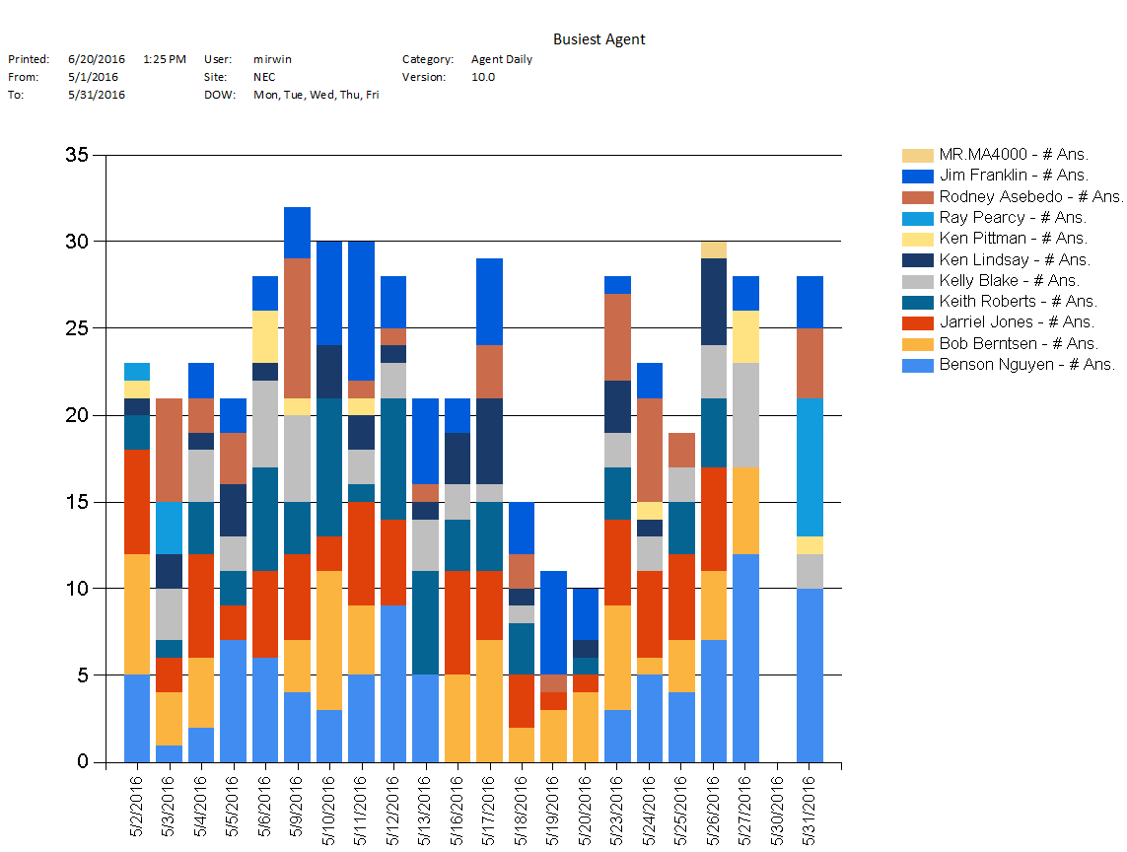
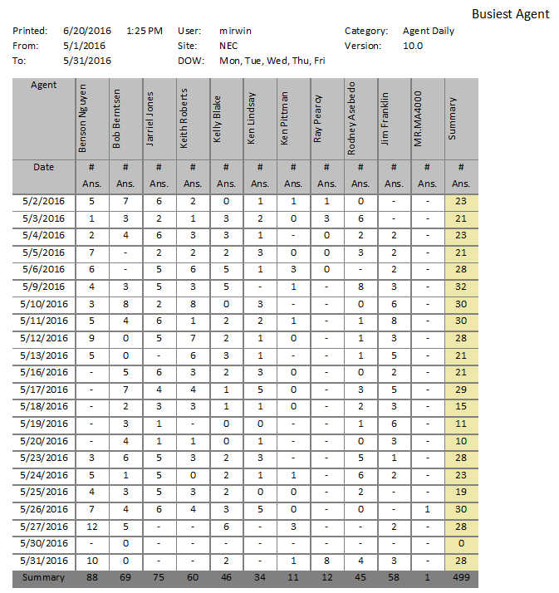
Historical Reporting
Reports:
      Create report(s)
      Answered Calls / Abandoned (Caller Hang up)
      Deflected Calls (Queue Full)/Overflow/Callbacks
      Hourly, Daily, Weekly, Monthly & Yearly Format
      Average Wait Time / Longest Wait Time
      Longest Wait time for the month in Hourly, Daily, Weekly & Monthly Format
      Longest Abandon Duration
      Agent States - Logged in, Logged out, Work Mode, Break Mode, etc.

Slide 25
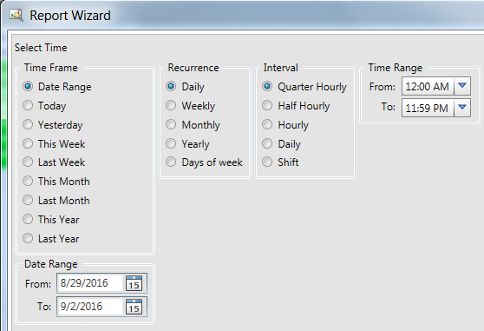


Report Wizard
Last entries saved making it faster to run different reports for the same data

Slide 26

Business Analytics
Report Scheduling
PDF, WORD, EXCEL – Daily/Weekly/Monthly
Auto Email Scheduled Reports

Slide 27

Call Activity – View Details by System & Split Monthly
Quarter-Hour
Half Hour
Hourly
Daily
Weekly
Days of the Week
Monthly
Yearly

Slide 28

Call Activity by Days of the Week
Quarter-Hour
Half Hour
Hourly
Daily
Weekly
Days of the Week
Monthly
Yearly

Slide 29

Agent Averages - spot anomalies quickly
Quickly spot anomalies between agents

Slide 30

Agent Audit – event based data for each agent
Event-based reporting on a per agent basis – narrow report criteria to review specific conditions

Slide 31

Contact History with UCE IVR
Integration with QueWorX for Auto Attendant options selected, ETA provided to caller, QD provided to caller and Callback offer.

Slide 32

Contact History Summary

Slide 33

Custom Report Designer
Type of Output

Slide 34



Custom Report Designer

Slide 35



Call Recording & Workforce Management
Encore Call Recording & Community WFM
  Intuitive UI
  Compliance Audit Log
  Encryption and Scrubbing
  Numerous Reporting and Export
  Screen Capture up to 3 monitors
  eCoaching

Slide 36



Link to Recordings from NEC Global Navigator

Slide 37


Recorded Interaction View from GNAV

Slide 38
UCE Contact Center Solution
Automated Call Distribution
ACD - Routes calls to agents
Pilot Routing – Number Called
Routing
Split Queueing – Wait for Agent
Call Recover-Agent Can’t Answer
Business Line vs ACD Line
Interactive Voice Response (IVR)
Play Announcements to Callers
ETA Announcements
IVR
Position in Queue
Custom Announcements
Callback options
UC/Agent Desktop
Presence/Stats
Agent & Split Statistics
Agent
Screen Pop
Call Control
Instant Message w/SME’s
Assist other Splits
Multimedia
Email & Web Chat
Emails – Answer & Track
Multimedia
Web Chats – Chat Phrases
CRM Lite–View All Transactions
Phone Notes – Document Conv
Supervisor Dashboard
Real-time Windows
Historical Reporting
Call Stats– ASA/LWC/Abandon
Supervisor
Agent Status – States & Calls
Calls in Queue– Track Progress
Reporting – On-demand/Sched

Slide 39




Demo # 214-262-5485
AA 214-262-9060
Option
Option
Claims
1
2
214-262-9061
214-262-9062
Customer Service

